Slide 1
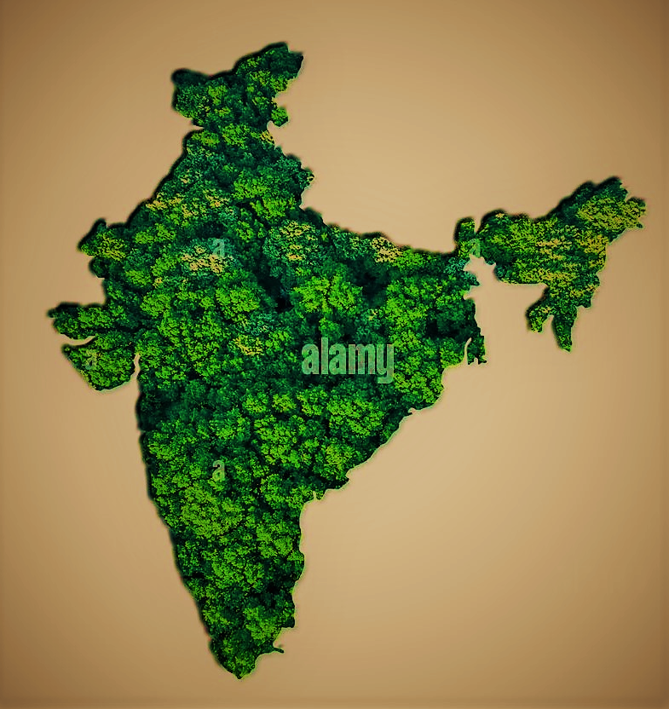
chapter - 14 India – forest Resources

Slide 2

Important things in this chapter
Types of forests in India and their distribution
Conservation of forests and methods of conservation
Wildlife sanctuaries and national parks
Biosphere Reserves

Slide 3
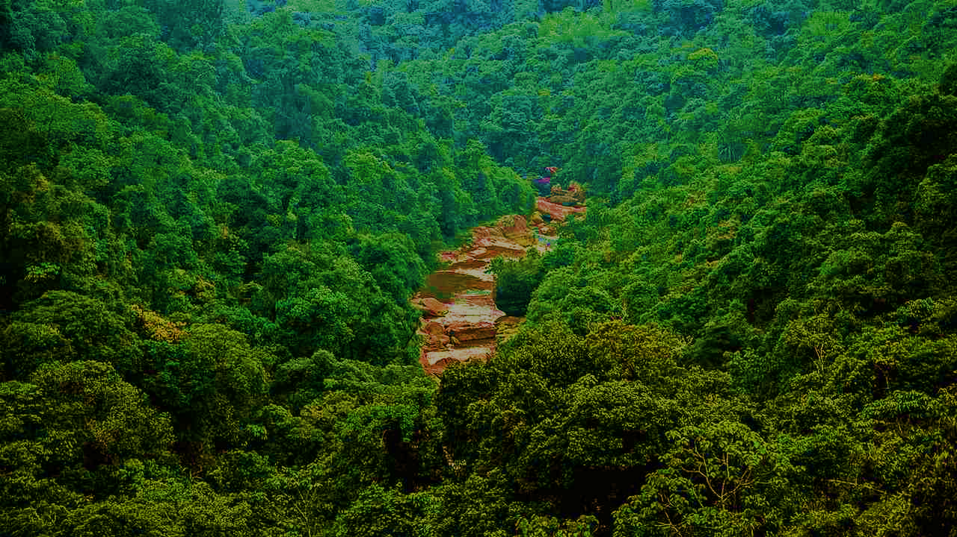
Forest
India is a land which has different specialities in it
One of its speciality is it’s
Natural Vegetation
Natural Vegetation :
The total plant life growing naturally in an area is called forest/natural vegetation.

Slide 4

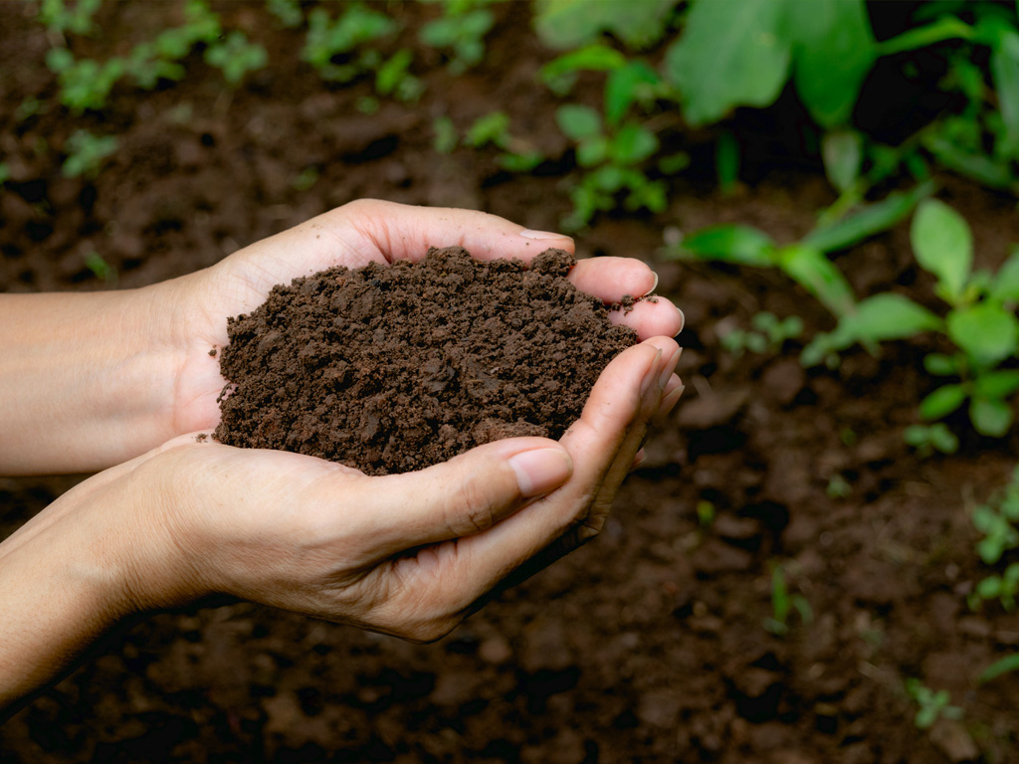
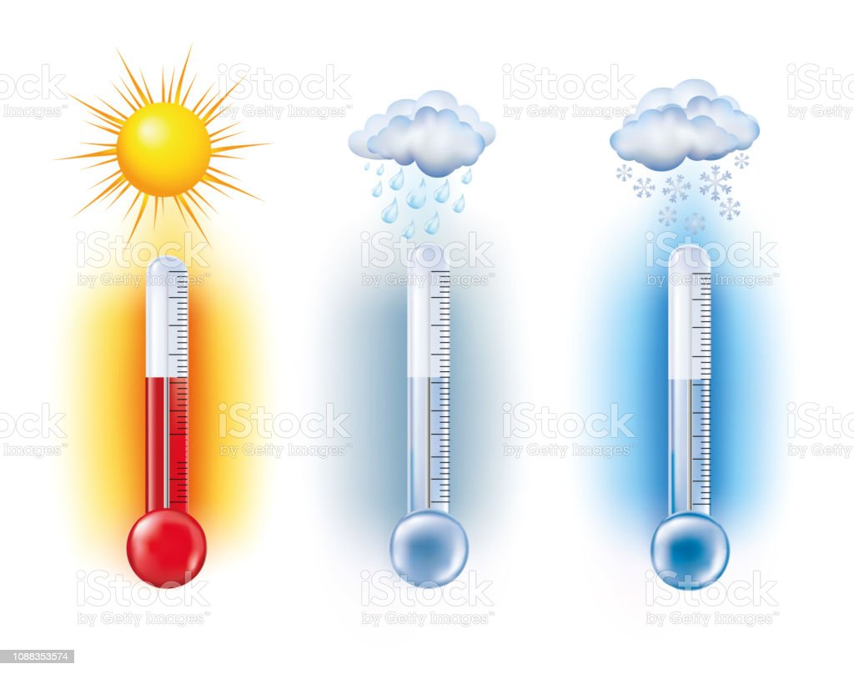
Reasons for rich forests are :
Good temperature
Proper rain
Land forms
Soil …….etc
India has 6.9 lakh km² of forest.
Forest covers an average of 21.2% of India’s
geographical area.

Slide 5
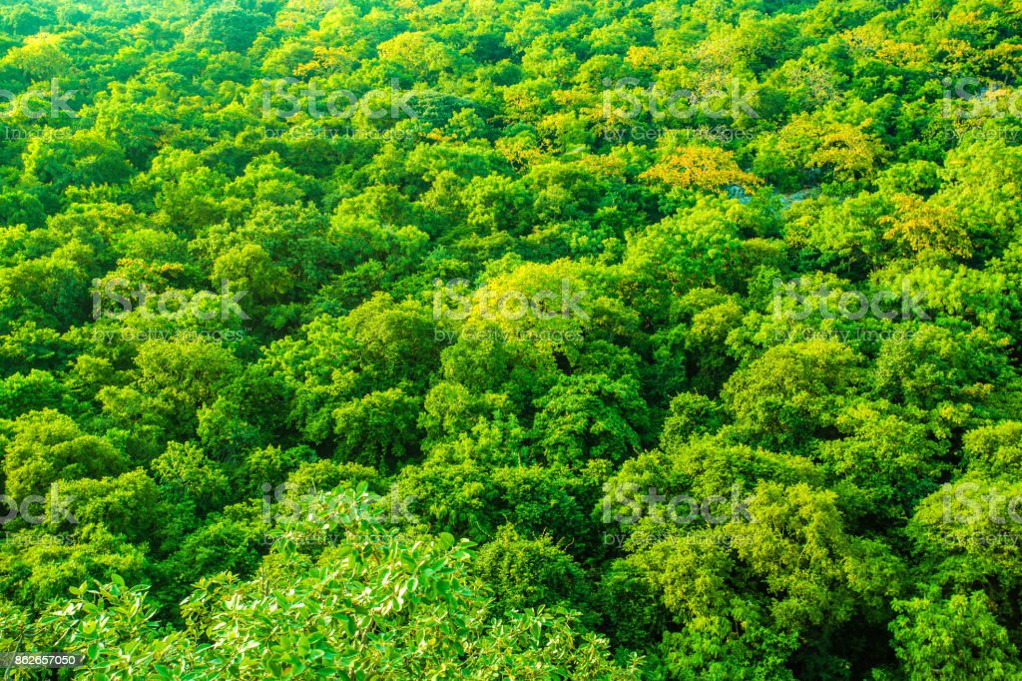
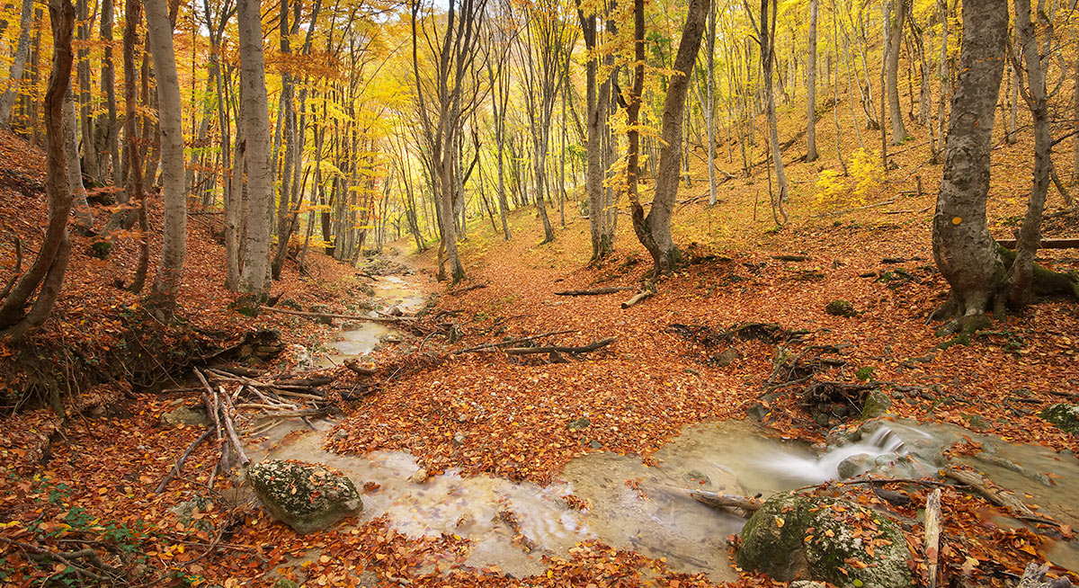
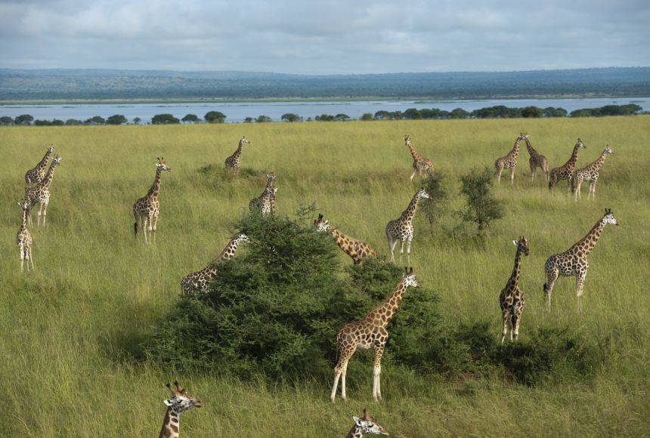
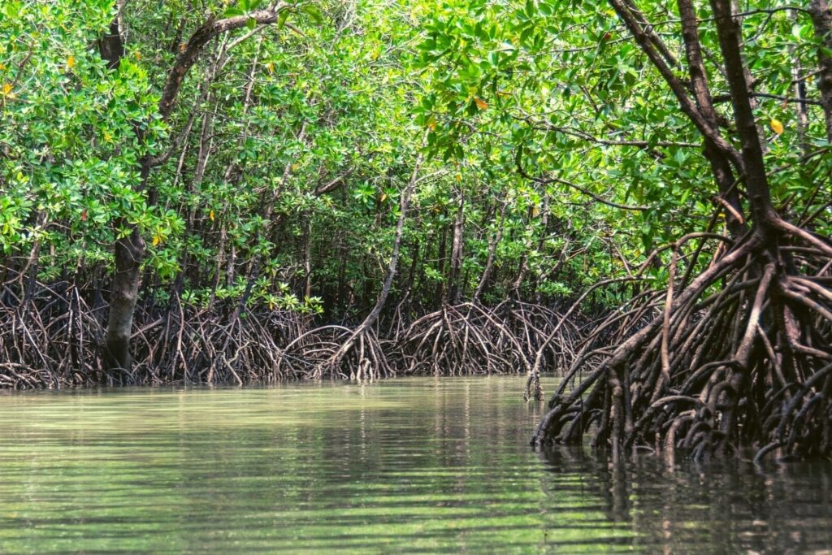
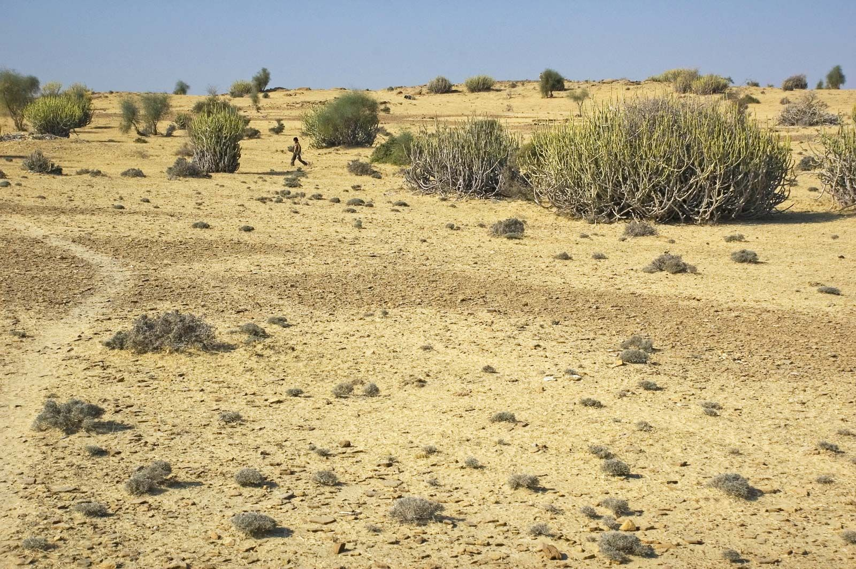
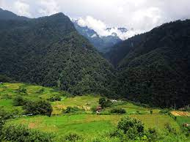
Types of Natural Resources
Evergreen Forests
Deciduous Forests
Tropical Grassland
Mangrove Forests
Desert Forests
Alpine forests of Himalayas

Slide 6
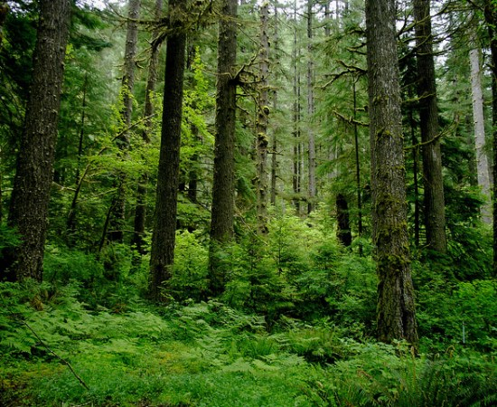
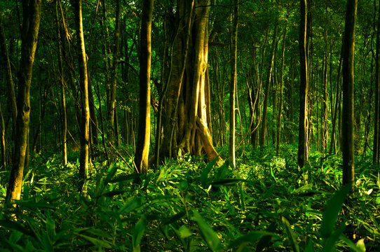
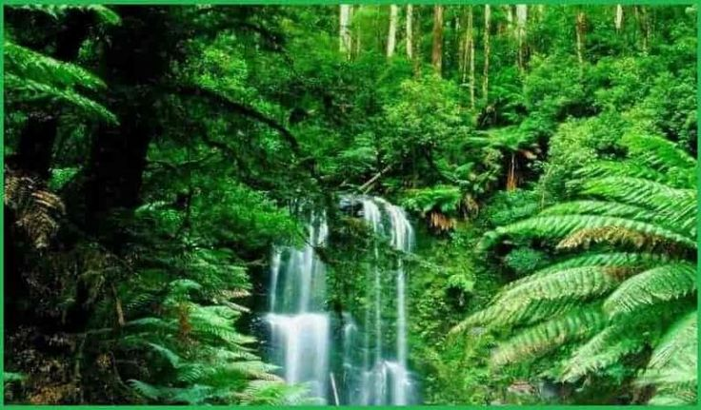
Evergreen Forests
These forests are found in areas of heavy annual rainfall exceeding 250 cm.
These forests are seen in the places below 900 mtrs above sea leval

Slide 7
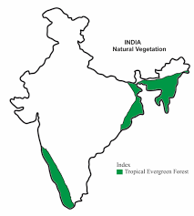
They are found mainly on the western slopes of the Western Ghats and hills of north eastern states of Assam, Nagaland, Meghalaya, Tripura, Manipura and Andaman – Nicobar islands
Area it covers is 2.6 lakh hectares.
Here trees will be always green, hence
it is called Evergreen Forest.

Slide 8
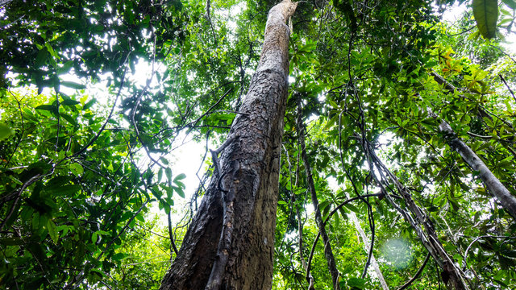
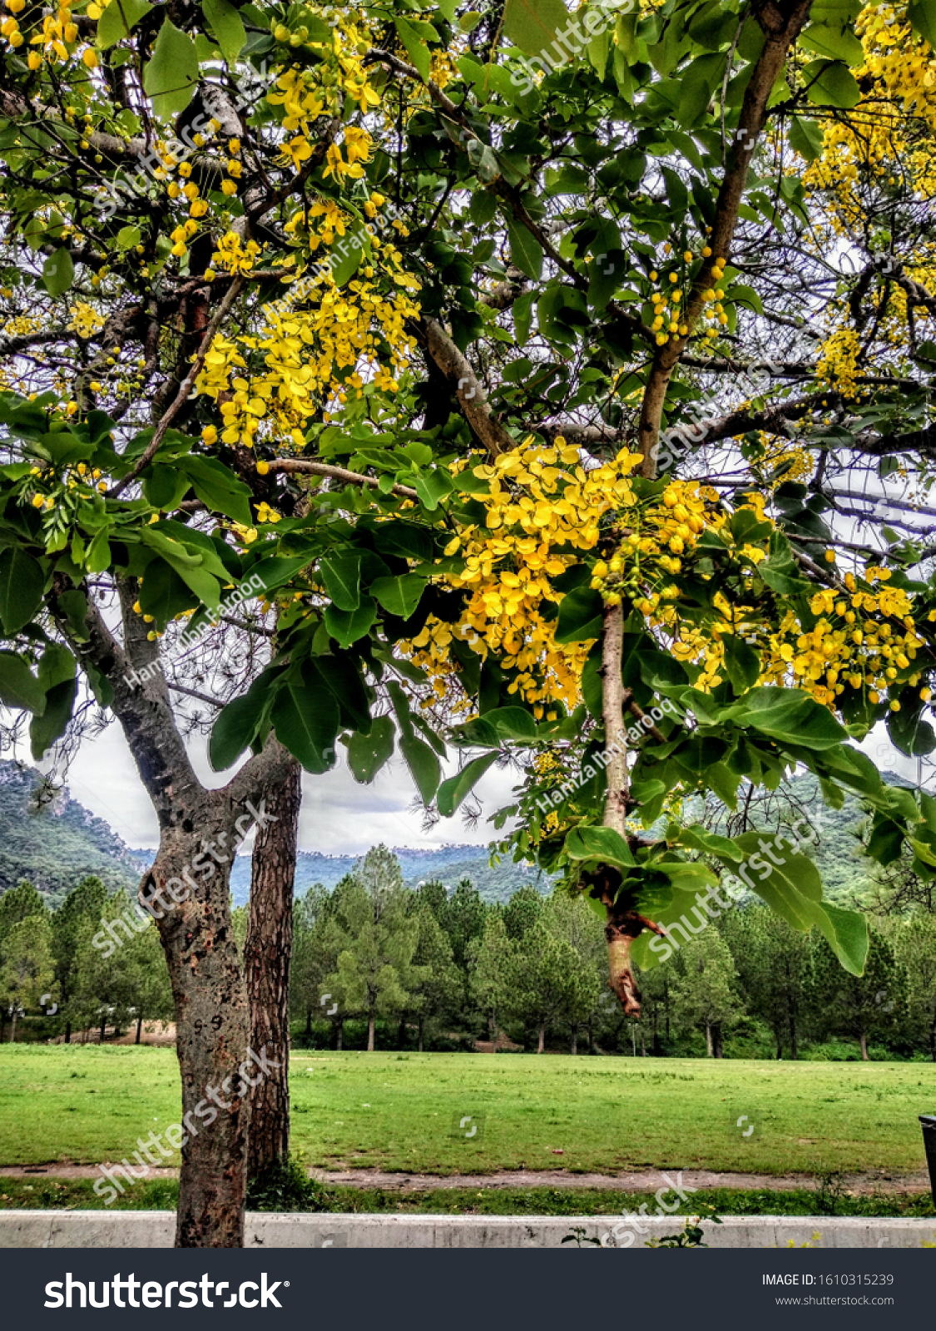
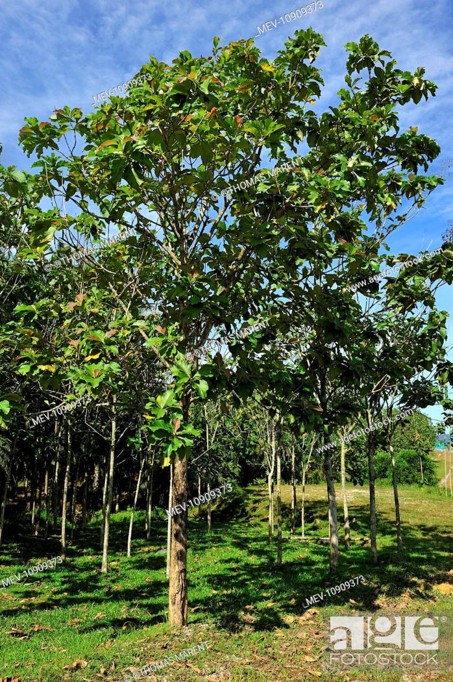
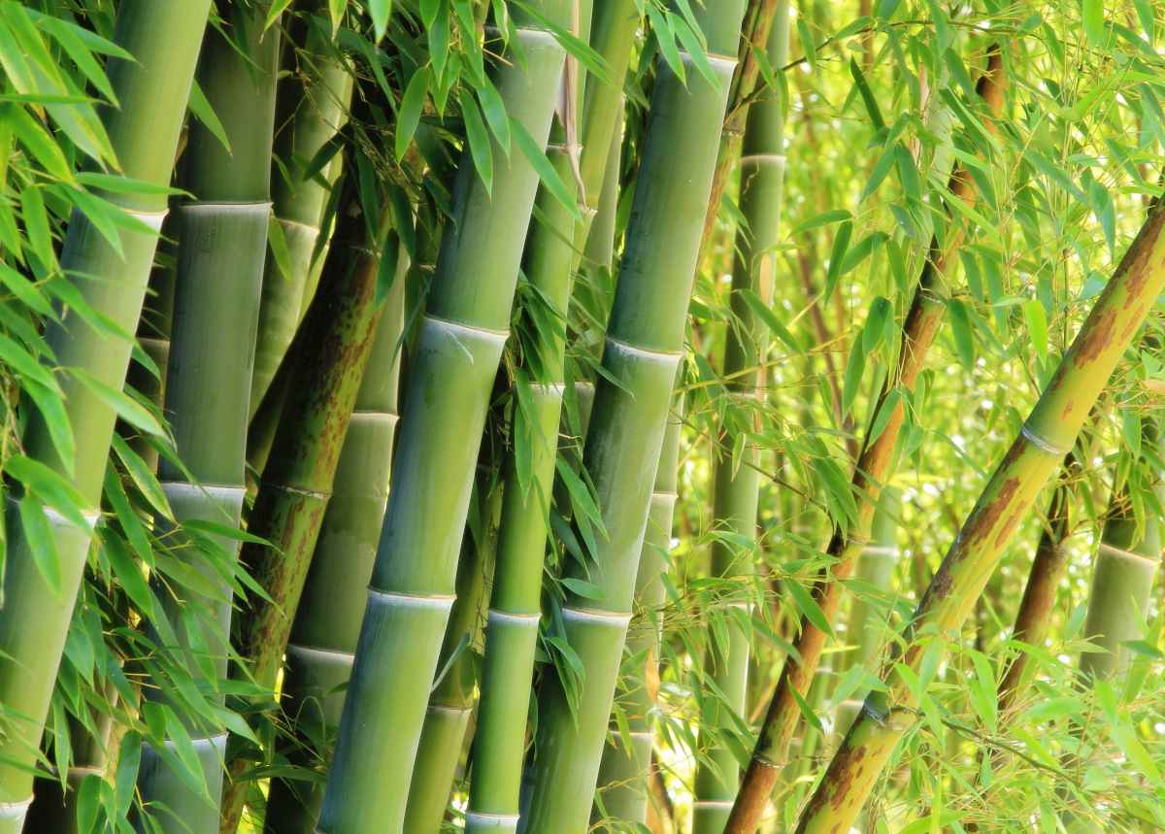
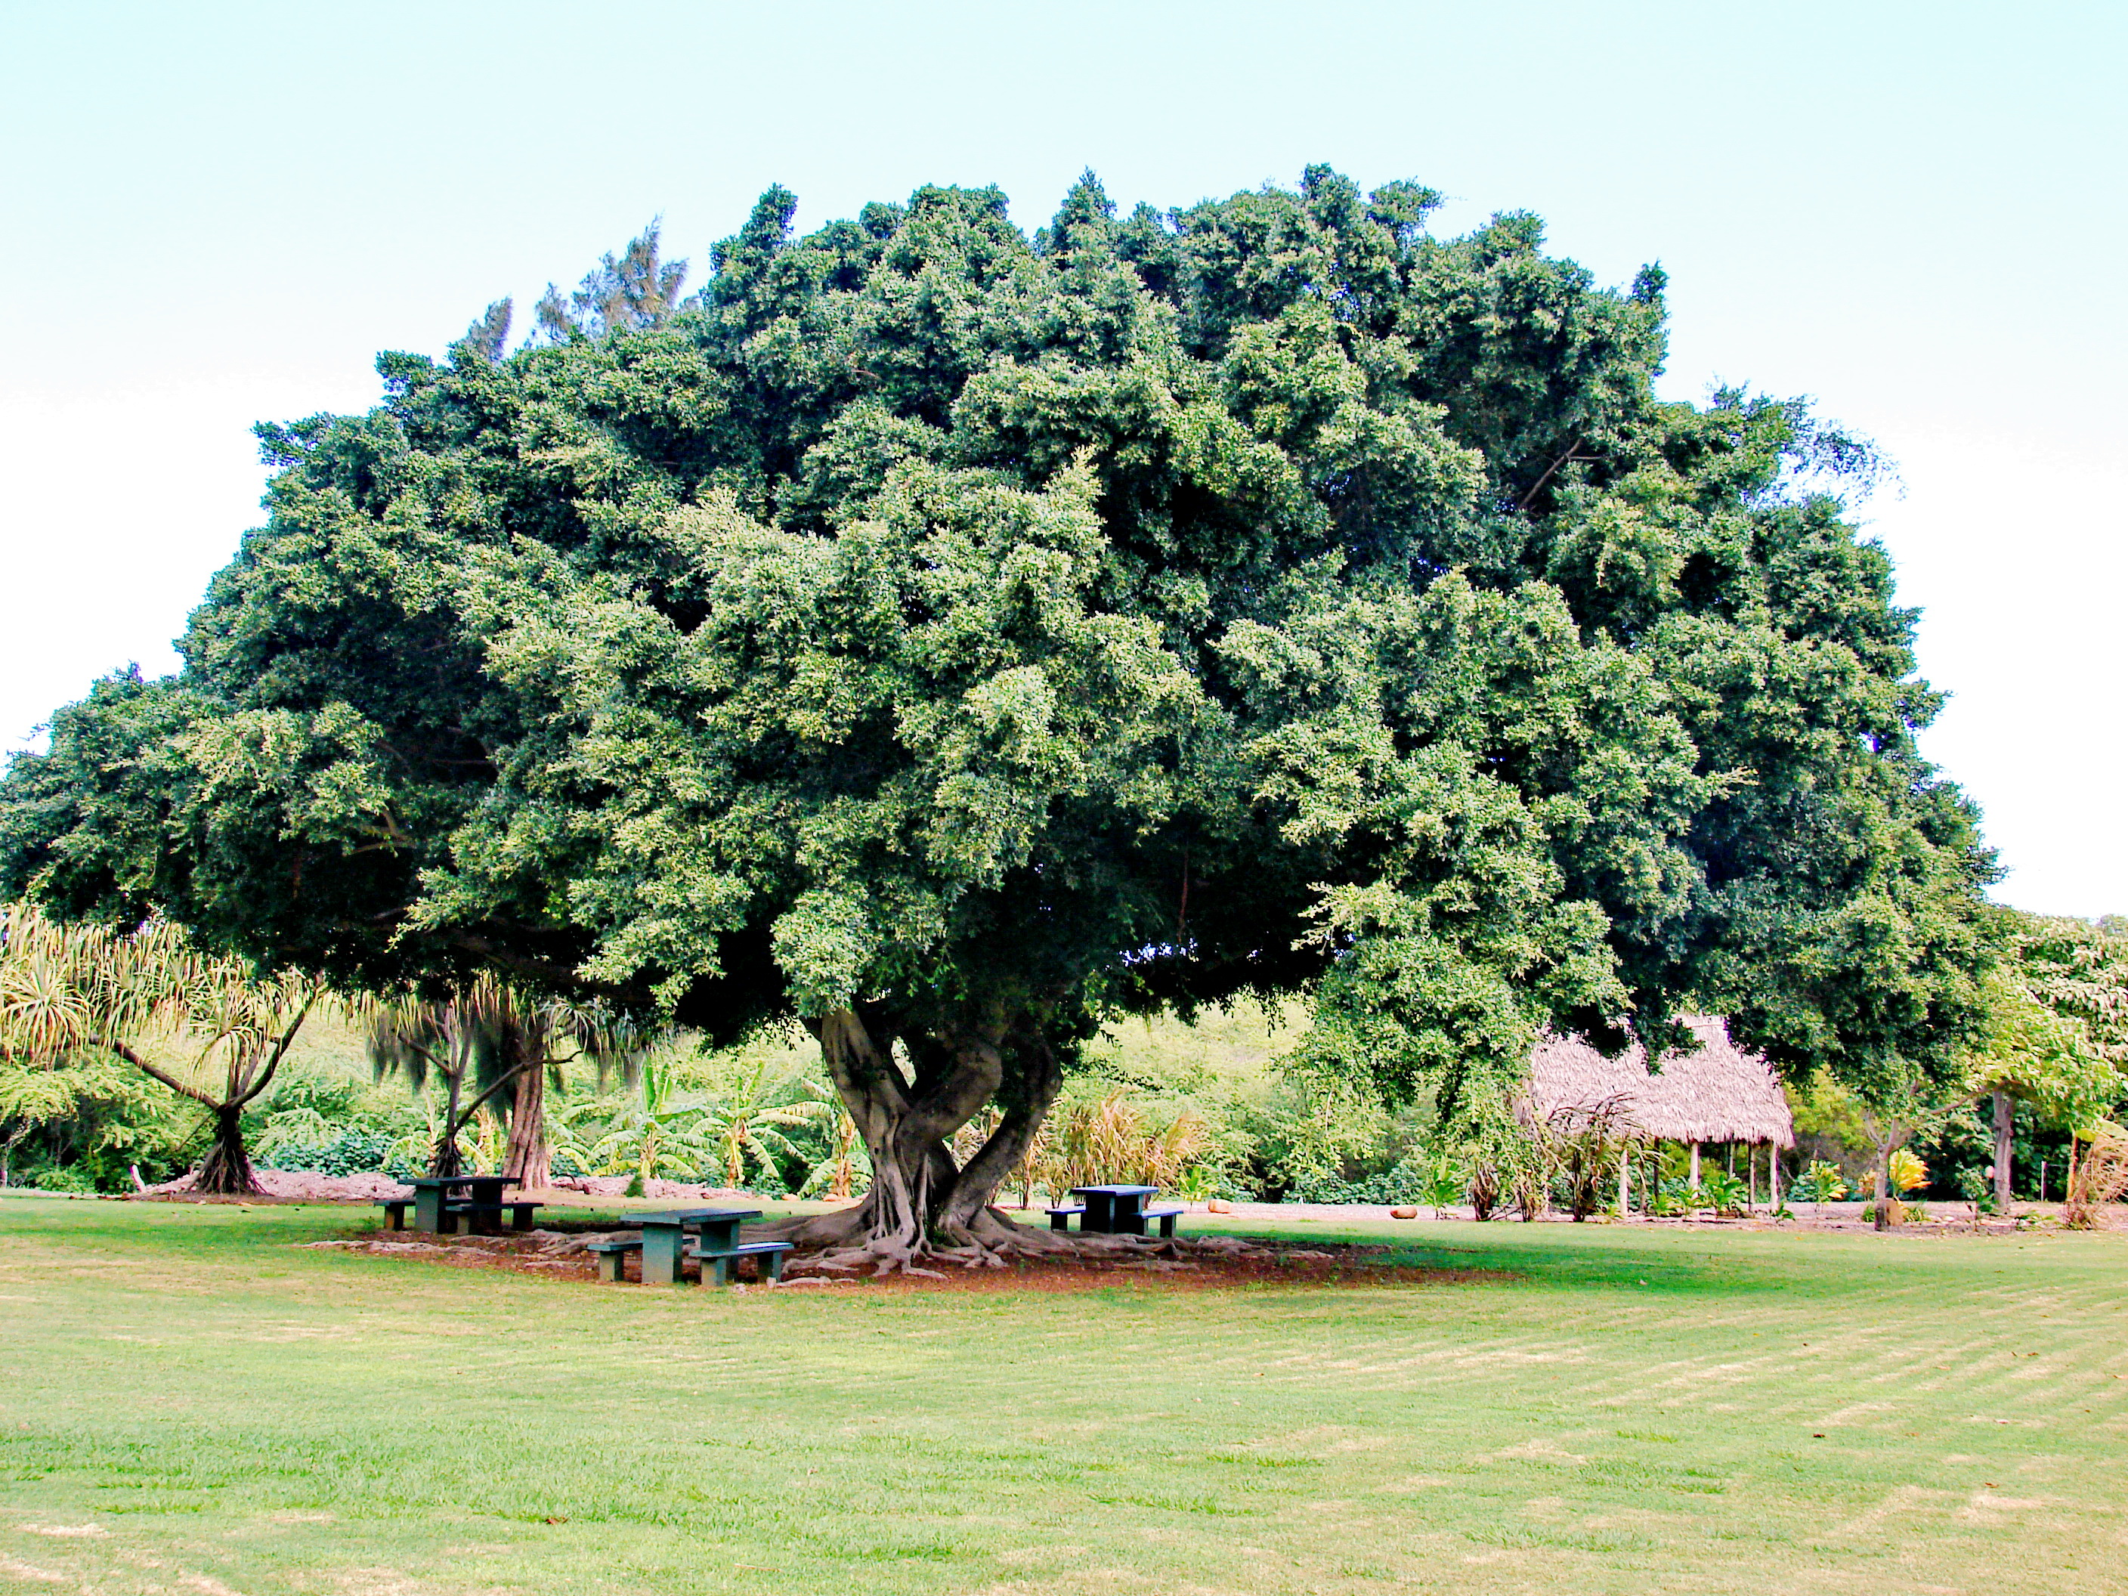
Trees found in Evergreen forests
Trees found in tropical evergreen forests are rosewood, malabar kino, teak, Indian laurel and bamboo.

Slide 9
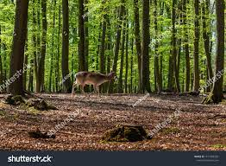
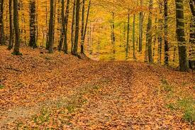
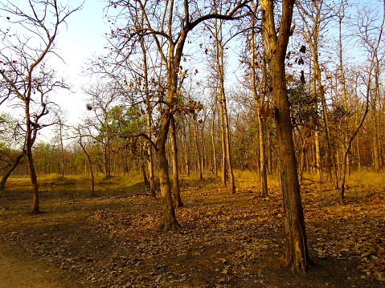
Deciduous Mansoon Forests
These forests are widely distributed in India, as India has mansoon climate.
These are found in areas with an annual rainfall of 75-250 cms.
It covers 65.5% of total area of forest.

Slide 10
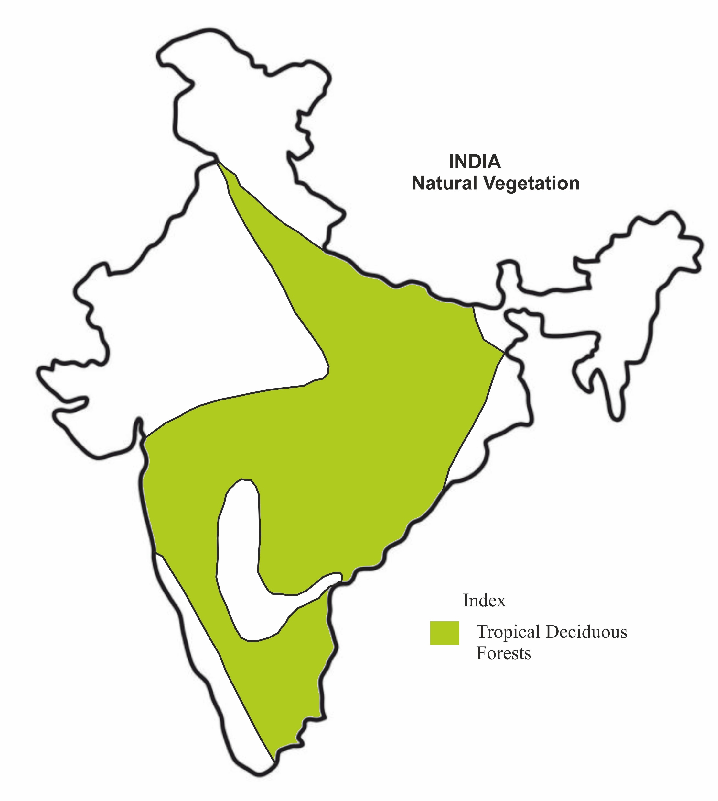
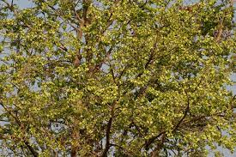
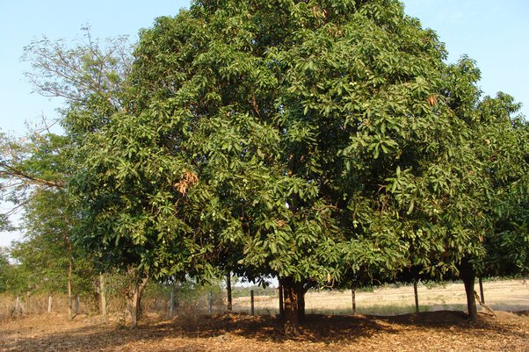
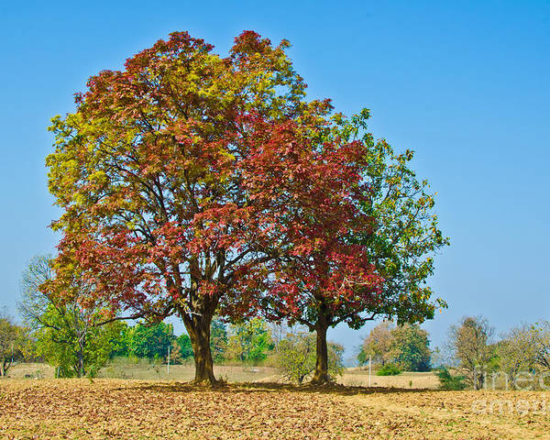
The trees in these forests shed their leaves during spring and early summer. Hence they are also known as ‘Monsoon Forests’.
The important trees are Teak, Sal, Sandalwood, Kusum, Kanju, Myrobalan, Siris, Mango, Neem, Tamrind etc.

Slide 11
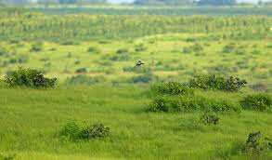
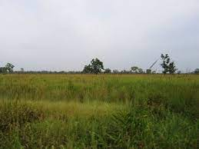
Tropical Grassland
These are found in areas having 60 to75 cms of rainfall.
These areas have tall grass and small herbs.

Slide 12
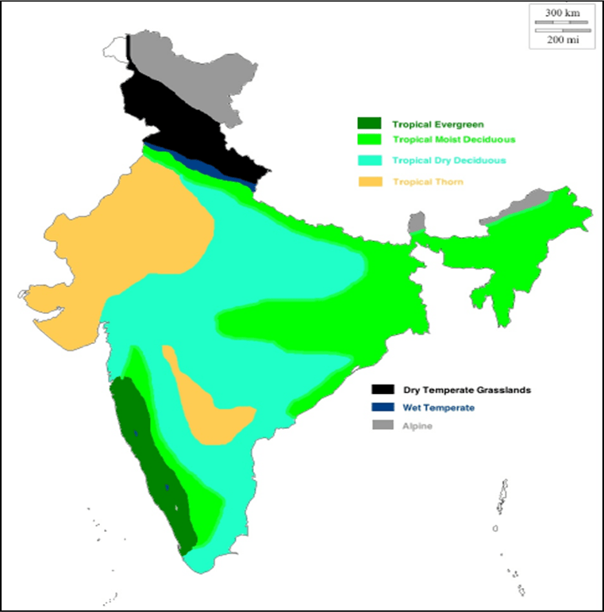
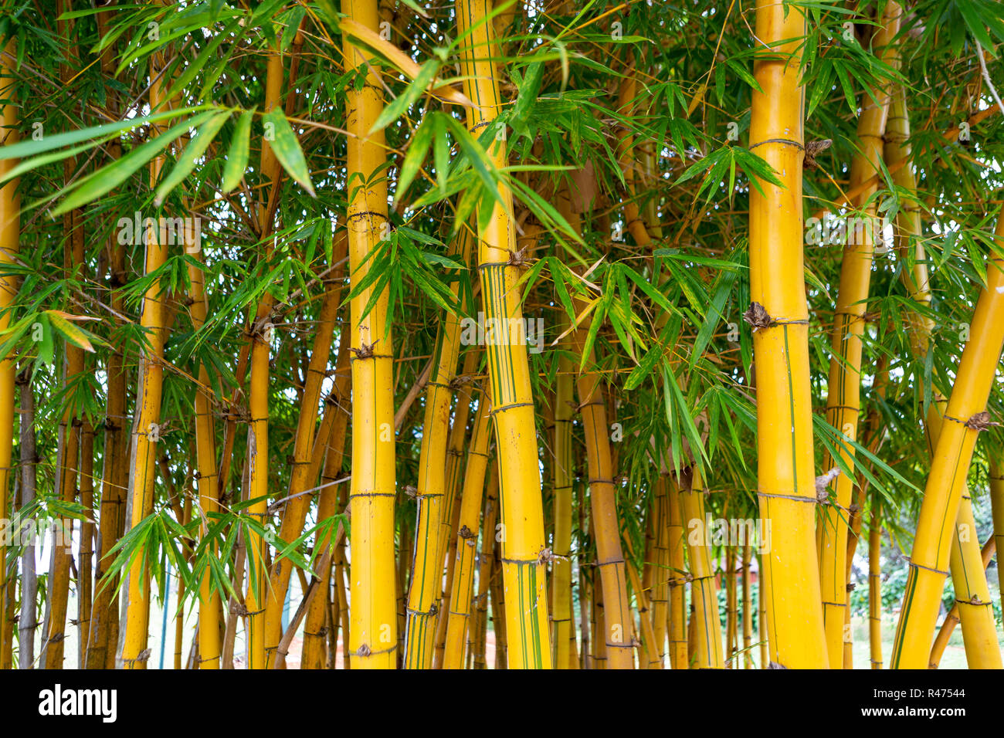
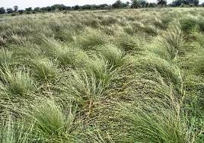
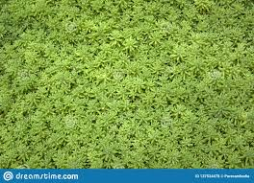
Central part of the peninsular Plateau, border areas of Thar desert to the west of Aravalli hills have this type of vegetation.
Babool, Seesum and Sabhai type of grass are seen in these areas.

Slide 13
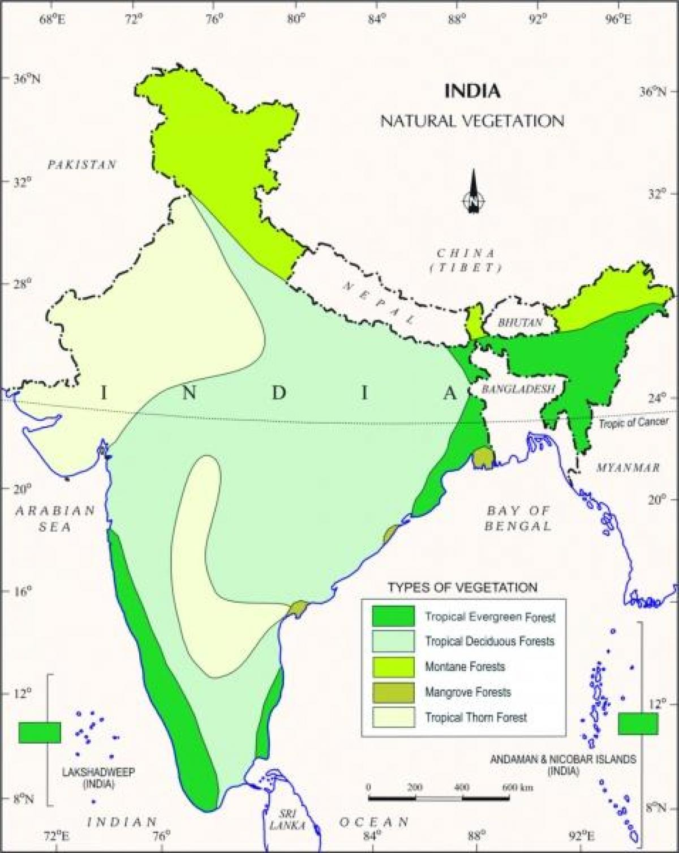
Mangrove forests
The Mangrove forests are found along the deltas and coastal regions and estuaries of rivers, that are subjected tides.
River delta of the Ganga, Mahanadi,
Godavari and Krishna have this kind
of forests.

Slide 14
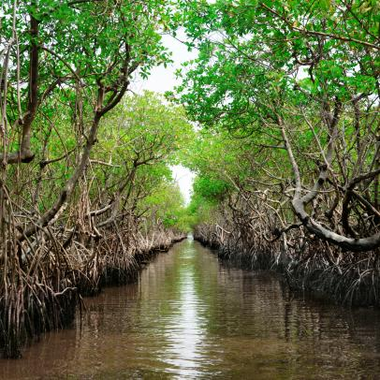
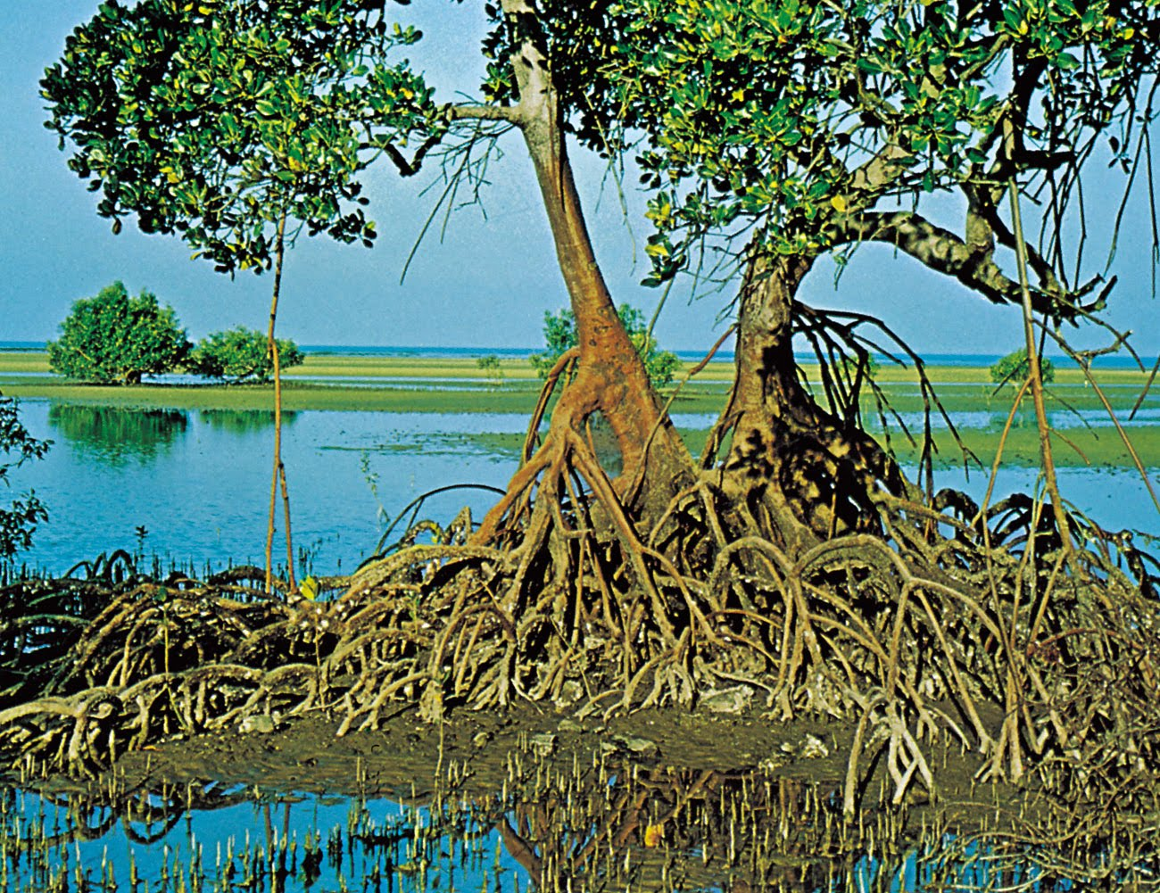
The ‘Sundari’ trees are plenty in the Ganga basin and hence these forests are called ‘Sundarbans’.
The total area of these forests is about 4.4 thousand kms.

Slide 15
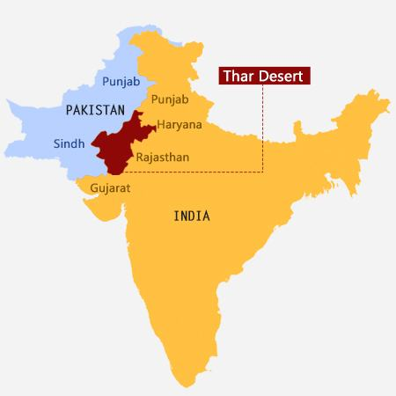
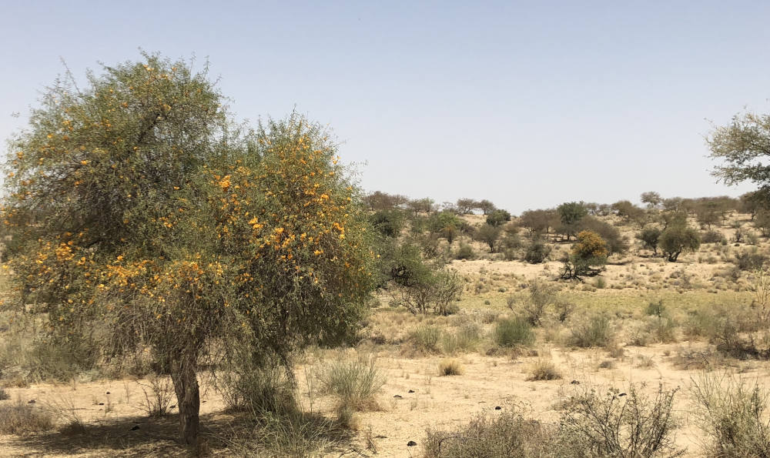
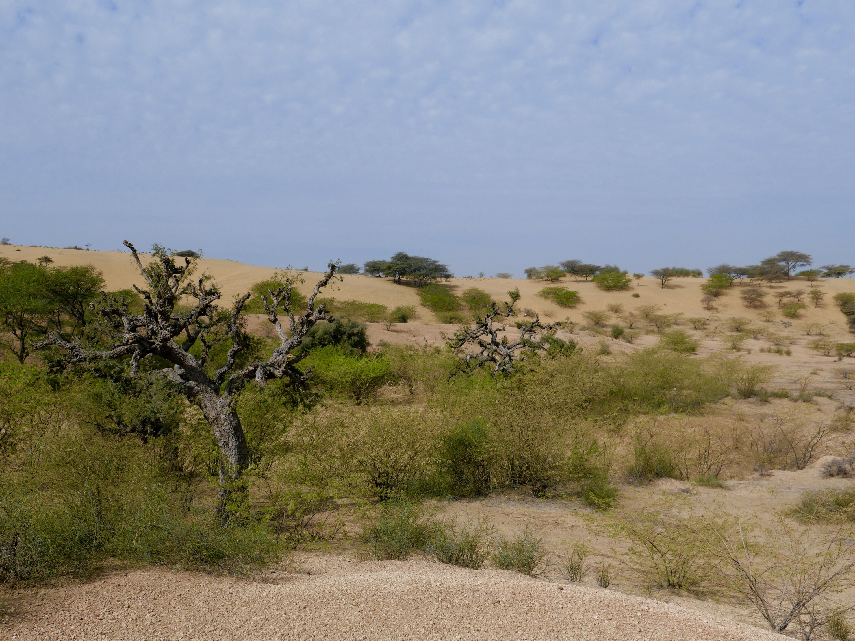
Desert forests
This type of vegetation is found in regions receiving less than 50 cms of rain.
The Thar desert in Rajasthan and its adjoining areas in Punjab, Haryana and Gujarat have these forests.
The plants are deep-rooted and
consists mainly of thorny shrubs.

Slide 16
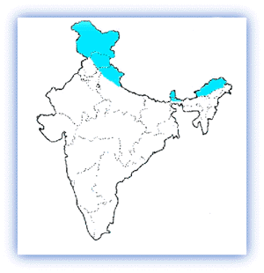
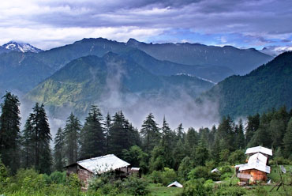
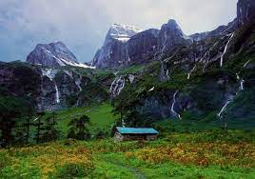
Alpine forests of Himalayas
Different types forests are found in the Himalayas.
According to the changes in climate, various types of plants are found. The important types of trees growing in this type of forest are sal, byra, toon, silver spruce, laurel etc.

Slide 17
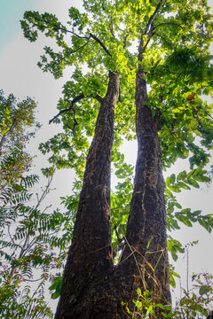
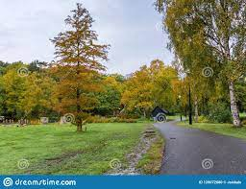
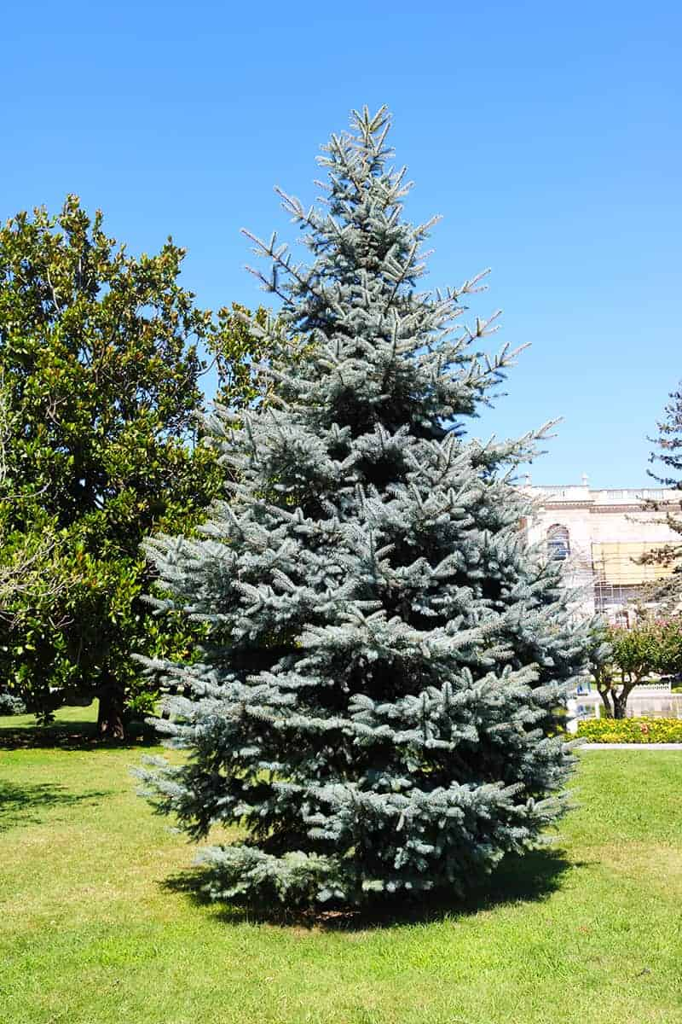
The trees growing in this region are
Sal tree Byra tree Silver spruce tree
These trees have pointed leaves.

